Slide 1
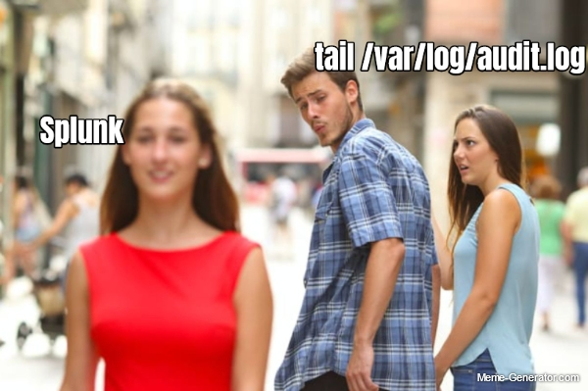

Incident Response Bootcamp with Splunk
10/26/2023

Slide 2
Minimum Onto Mastery
Step #1 – Logs.
You need to have record of something happening in order to detect it
Step #2 – Threats + Tactics, Techniques, Procedures (TTPs).
You need to know what is bad activity
Step #3 – Triage.
You need to know how to determine what is normal and what isn’t
Think process + procedure
Step #4 – Threat Hunting.
You should be able to look at any set of logs and find abnormal activity
© 2023, Anna Andler. All rights reserved Introduction to Threat Hunting (with Splunk) ver. 1.2 – Adapted for CyberForce Introduction for Security Daemons 2

Slide 3
Threat Detection vs Threat Hunting
Detection = Reactive
Log search logic is predetermined and built against current threat landscape
Tactics Techniques (TTPs)
Threat Hunting = Proactive
System artifacts / Indicators of Compromise (IoCs)
Known or Unknown threats
Points of Persistence (POP)
Both = discover what falls through the cracks of security controls/policy
© 2023, Anna Andler. All rights reserved Incident Response (with Splunk) ver. 1.2 – Adapted for CyberForce Introduction for Security Daemons 3

Slide 4
***You need LOGS to build detections***
Network –
firewall (allowed / blocked traffic)
Service Logs –
Web Server access logs (http requests, error logs)
DNS queries
Account Logins –
success/fails by user
System Logs -
File access (read / write / execute)
EDR Logs – Windows Defender
© 2023, Anna Andler. All rights reserved Introduction to Threat Hunting (with Splunk) ver. 1.2 – Adapted for CyberForce Introduction for Security Daemons 4

Slide 5
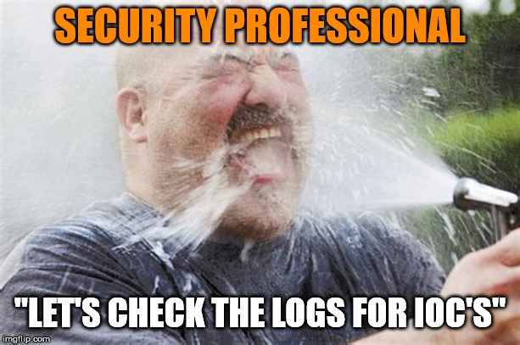
Parsing Log Data
Logs fill up fast. Malicious and benign activity.
Log Format:
is standardized by source type
General Log Type + File/Group.
EX. Windows Security Log, Linux Audit Logs
tells you what each piece of data represents
EX. 12345 - time, process ID, username, etc?
Now, you know what to extract from each log
© 2023, Anna Andler. All rights reserved Introduction to Threat Hunting (with Splunk) ver. 1.2 – Adapted for CyberForce Introduction for Security Daemons 5

Slide 6


Detection Lab – Log Events

Slide 7
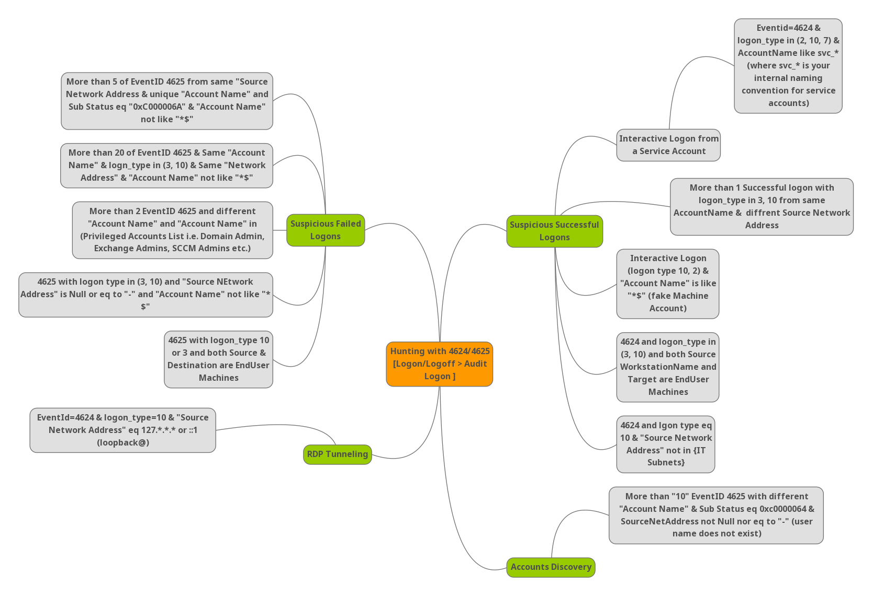
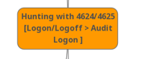
EX. Windows Login
© 2023, Anna Andler. All rights reserved Introduction to Threat Hunting (with Splunk) ver. 1.2 – Adapted for CyberForce Introduction for Security Daemons 7

Slide 8
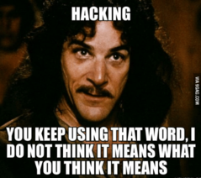
Think Like An Attacker
TTPs = Tactics, Techniques, Procedures; tldr ways attackers “hack you”
Gather: #1 - Identify Attack Surface - What’s accessible (ports, services, apps…)
#2 - Identify Vulnerabilities - Misconfigurations, CVEs, etc.
#3 – TTP Heuristics / IoCs – Signs of a threat (requests, modifications…)
TTPs:
Initial Access
Exploit CVE, Compromised User Account, Web Vuln, etc.
Privilege Escalation + Persistence
Users/Groups, Remote Access/Mgt Services, C2s, Run Keys, Scheduled Tasks, etc.
Lateral Movement
Remote Access/Mgt Services, User/Groups, etc.
Data Exfiltration
© 2023, Anna Andler. All rights reserved Introduction to Threat Hunting (with Splunk) ver. 1.2 – Adapted for CyberForce Introduction for Security Daemons 8

Slide 9
Detection Lab – Attack Surface

Slide 10
Making a Detection Sandwich
for each TTP you want to detect >>
Know what to look for – IoCs
Identify logs types you need to define a threat / find IoCs
Extract fields from each log you need to compare against IoCs
Optional – write search logic to automatically compare IoC to log event
© 2023, Anna Andler. All rights reserved Introduction to Threat Hunting (with Splunk) ver. 1.2 – Adapted for CyberForce Introduction for Security Daemons 10

Slide 11
Detection Triage
You receive an alert from a detection – now what?
Search logic can produce False Positives
Determine if the ‘threat’ is benign or suspicious/malicious
What is the Threat? – know what it means before continuing
Identify:
Target Host (usually an internal asset)
Source Host (usually the external ‘threat’)
Process/Service (if applicable)
User (if applicable)
Other IoCs
© 2023, Anna Andler. All rights reserved Introduction to Threat Hunting (with Splunk) ver. 1.2 – Adapted for CyberForce Introduction for Security Daemons 11

Slide 12
Detection Triage
Are there other affected assets?
Check other log types
Check other internal assets for source activity
Compare:
Against baseline of “normal” / known activity
Against what the threat / attack is
(Real world -- Use external threat feeds)
Determine Disposition:
True positive = Suspicious Activity
Benign Positive = Suspicious but expected
False Positive = Incorrect Analytic Logic / Inaccurate Data
Undetermined = Not enough information
© 2023, Anna Andler. All rights reserved Introduction to Threat Hunting (with Splunk) ver. 1.2 – Adapted for CyberForce Introduction for Security Daemons 12

Slide 13
“Incident” Timeline
Who
IP, Domain, User Accounts
What (was compromised)
Think CIA Triad – Credit card info? System downtime? Unauthorized changes?
Where (which systems / networks)
When (exact time for each part of the chain)
How (did the attacker gain access)
Exploited a 0-day? Logged in with default credentials?
© 2023, Anna Andler. All rights reserved Introduction to Threat Hunting (with Splunk) ver. 1.2 – Adapted for CyberForce Introduction for Security Daemons 13

Slide 14
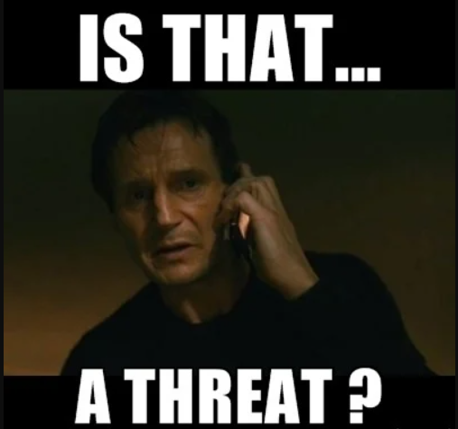
Incident Response Reports
When you find a real threat, submit an IR report
1. Make the event timeline –
Source Host/IP, initial access vector, what did they do (modification, exfiltration, persistence, etc.)
2. Remediation Plan what did you do to fix it
3. Lessons learned from breach (if applicable)
Disclaimer: In the real world, you *escalate* and don’t call it an incident
© 2023, Anna Andler. All rights reserved Introduction to Threat Hunting (with Splunk) ver. 1.2 – Adapted for CyberForce Introduction for Security Daemons 14

Slide 15
Detection Lab – Attack Chains

Slide 16
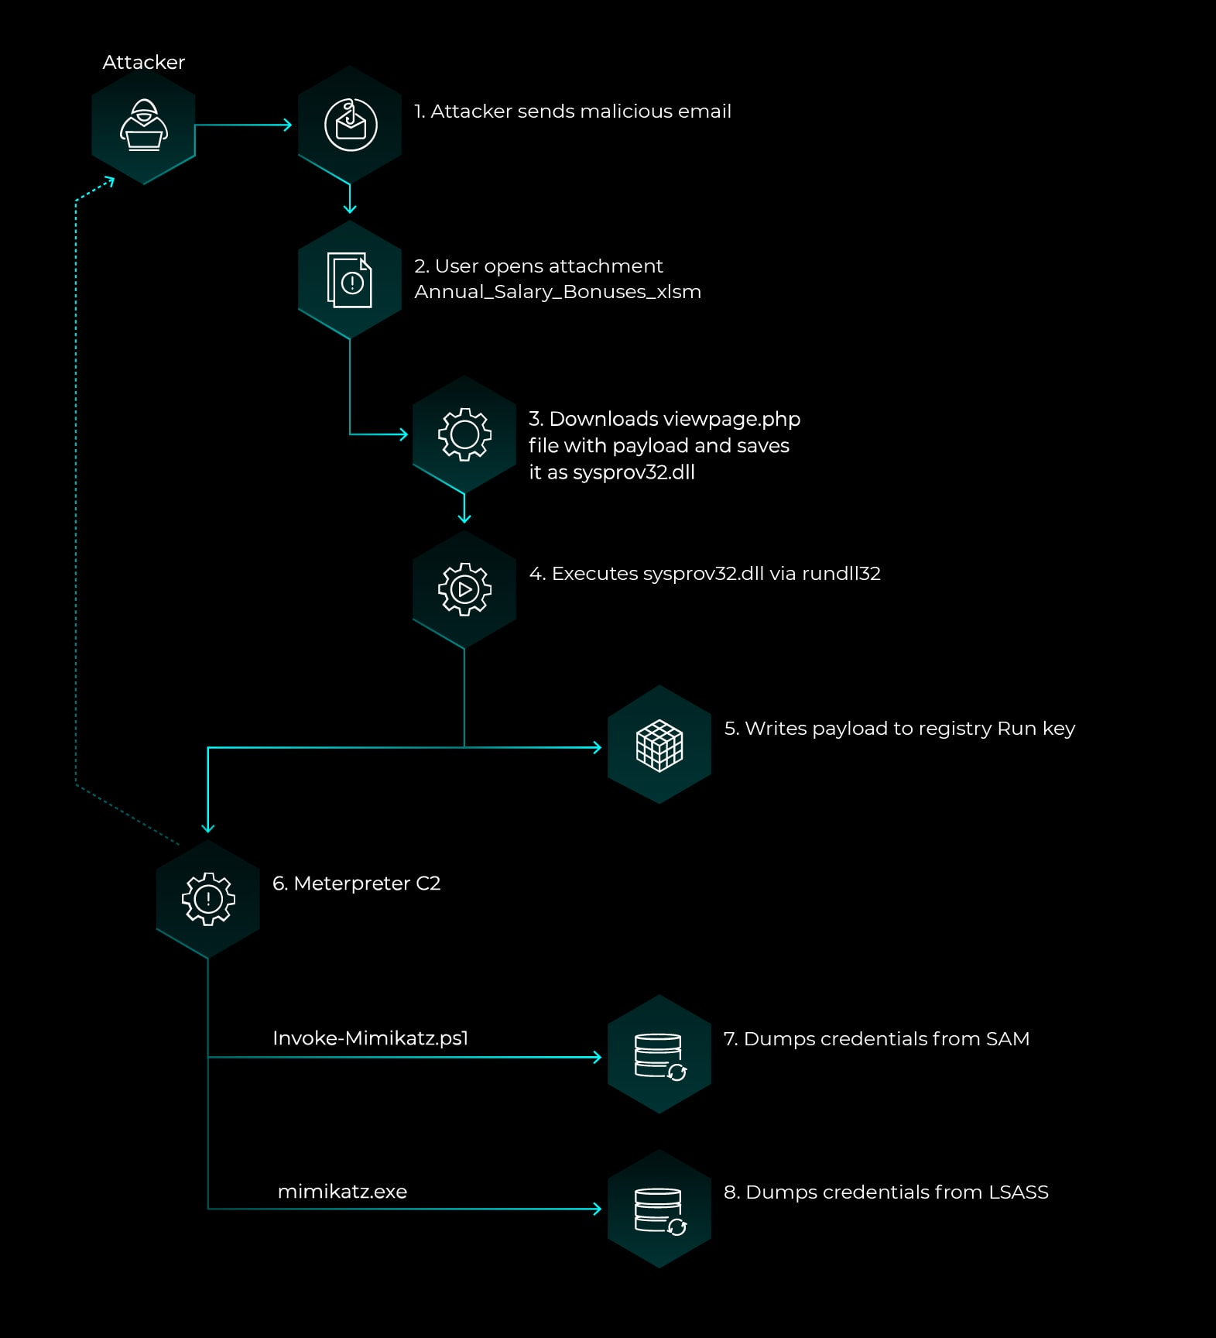
EX. Phishing

Slide 17
Intro to Threat Hunting

Slide 18
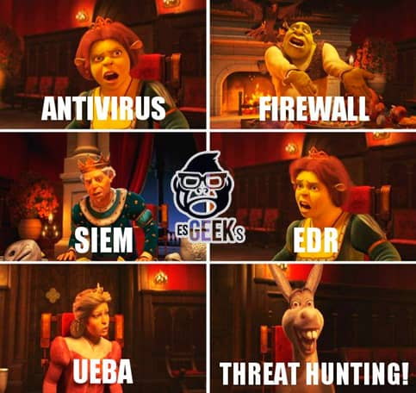
3 Steps to be an effective threat hunter
Know Normal –
System (Service/OS/Application/etc) Baseline
Know Attacker TTPs -
Persistence, Initial Access Vectors, Privilege Escalations, etc
Have Effective Tooling –
Logging – Auditd, Sysmon
LOLBins, Sysinternals
Log Centralization – Splunk, Wazuh, OpenEDR
© 2023, Anna Andler. All rights reserved Incident Response (with Splunk) ver. 1.2 – Adapted for CyberForce Introduction for Security Daemons 18

Slide 19
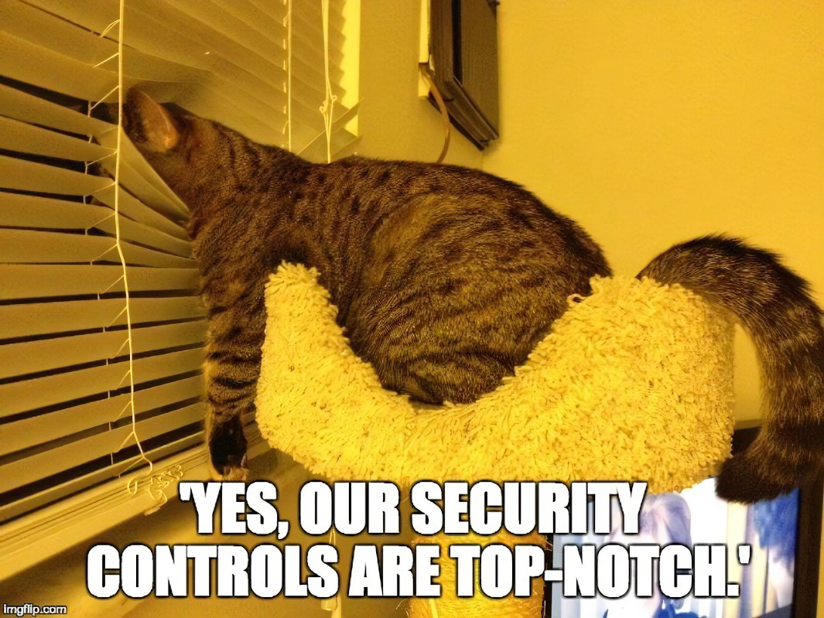
Baselining
“default” state of system – how things should behave
REVIEW >>
Processes / Services
Applications / Libraries
Network Connections
Registry Keys
Service Configurations
File Permissions
Scheduled Tasks
© 2023, Anna Andler. All rights reserved Introduction to Threat Hunting (with Splunk) ver. 1.2 – Adapted for CyberForce Introduction for Security Daemons 19

Slide 20
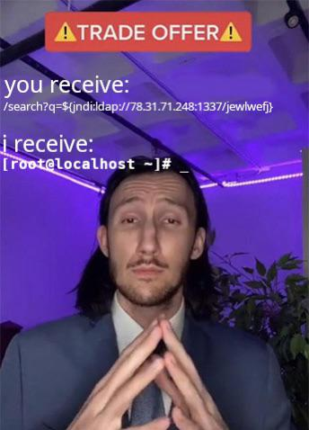
Points of Persistence (POP)
places/things attackers use to establish a foothold in your network
High Level Qualities –
Persistent: System state can change, access will not
EX. A system reboot
Automatic: If one point is remediated, another will re-establish it
EX. User account is deleted, but when you log in again, the user is back
(Blends in): Exhibits “normal” behavior
Good attackers follow this
EX. User account follows employee username e.g., anna.andler
EX. Uses LOLBins: at, netsh, etc.
© 2023, Anna Andler. All rights reserved Introduction to Threat Hunting (with Splunk) ver. 1.2 – Adapted for CyberForce Introduction for Security Daemons 20

Slide 21
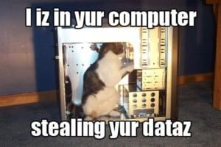
Threat Hunting via Persistence Type
Processes
Applications / Libraries / Packages
Services
Run Keys / Login Profile Backdoors
Scheduled Tasks
DLL / Process Injection
Tampering w/ Security Settings
Users/Group Permissions
File Permissions
Web Shells
© 2023, Anna Andler. All rights reserved Introduction to Threat Hunting (with Splunk) ver. 1.2 – Adapted for CyberForce Introduction for Security Daemons 21

Slide 22
Threat Hunting via Log Artifacts
Authentication Logs
Log-ins outside of work hours
Abnormal location (e.g. login from India when US-based employee IP)
Unauthorized privilege invokes
Network Logs
Callbacks/Requests to suspect IP
DNS Logs
queries to suspect domain
Web / Other Service Logs
Suspect web requests – HTTP Methods, Strings, Obfuscation
Process Execution Logs
File Modifications
Scheduled Task Execution History
Other System Modifications
Unexpected system reboot
© 2023, Anna Andler. All rights reserved Introduction to Threat Hunting (with Splunk) ver. 1.2 – Adapted for CyberForce Introduction for Security Daemons 22

Slide 23
Windows POP (points of Persistence)
**Verify Service Integrity & Disable malicious & rouge Remote Access services:
User Compatibility Backdoors
Run Keys
Scheduled Tasks
DLL / Process Injection
Group Policy / Local Security Policy
RID Injection & Users / Groups
Event Log Parsing
/etc/hosts or beacons
Arp table
© 2023, Anna Andler. All rights reserved Introduction to Threat Hunting (with Splunk) ver. 1.2 – Adapted for CyberForce Introduction for Security Daemons 23

Slide 24
Linux POP (points of Persistence)
Bash history & Modified Files (THINGS BEFORE YOU GOT ACCESS)
**Look at running processes & network connections & compare against baseline
**Verify Service Integrity & Disable malicious & rouge Remote Access services:
Login Shell Backdoors
Capabilities / File Permissions
Scheduled Tasks
Bash.rc / Shell Preference Backdoors
PAM Modules
Kernel Modules
/etc/hosts
Users / Groups
Audit/Auth/Web Log Parsing
Arp Table
© 2023, Anna Andler. All rights reserved Introduction to Threat Hunting (with Splunk) ver. 1.2 – Adapted for CyberForce Introduction for Security Daemons 24

Slide 25
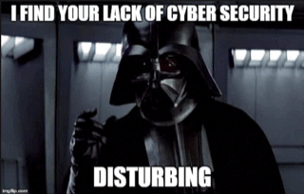
Tooling & LOLBins
Auditd:
Sysinternals:
Autoruns
Process Hacker
Sysmon
LOLBins:
Netstat
Ps / pstree or Task Manager
© 2023, Anna Andler. All rights reserved Introduction to Threat Hunting (with Splunk) ver. 1.2 – Adapted for CyberForce Introduction for Security Daemons 25

Slide 26
Threat Hunting Lab – POP

Slide 27

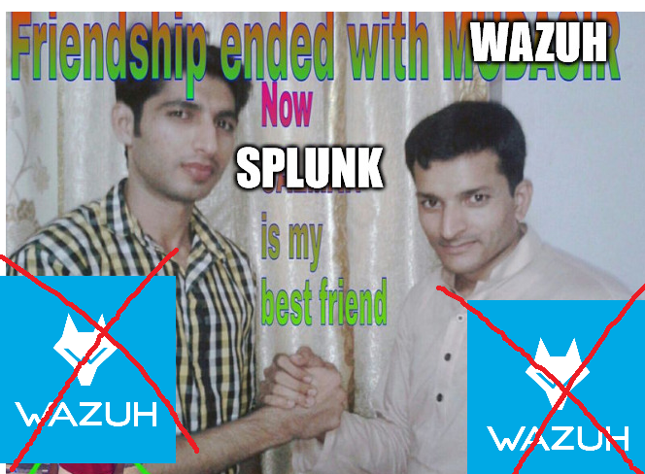
Now Moving on to SPLUNK

Slide 28
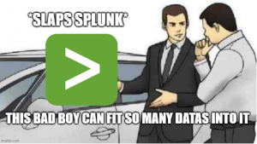
What is Splunk?
SIEM - Security Information and Event Management
Fancy way of saying centralized logging with detections
Splunk is NOT a SIEM
Top Capabilities –
Data management platform
Searching data across multiple devices in one place
Analyze the data w pretty charts
Correlate Different Logs
Automate SOC Response w/ Alerts and Reports
© 2023, Anna Andler. All rights reserved Introduction to Threat Hunting (with Splunk) ver. 1.2 – Adapted for CyberForce Introduction for Security Daemons 28

Slide 29
Splunk Components (The Jargon)
Apps – Typically an installed package that enhances Splunk’s capabilities. Some apps can also install pre-made dashboards
Indexes – Where data gets organized into once ingested by Splunk
Default is main. You can also make custom indexes to organize data in receiving settings
Forwarders – The data senders. Configured w/ Splunk Universal Forwarders
Input – A file or folder Splunk is set up to monitor (ingest)
Receivers – The ports which Splunk can obtain data from. TCP 9997 is default Universal Forwarder Receiver & UDP 514 is default Syslog receiving port. Both must be configured
Search & Reporting – The default app for parsing through data manually and via automation
Alert – A custom action that triggers on a certain event set within a time interval. (EX - a notification is sent when a new admin account is created)
Dashboard – A custom set of searches that can be in graphical or tabular form
Report –A printed version of a dashboard that is set to export at set intervals
© 2023, Anna Andler. All rights reserved Introduction to Threat Hunting (with Splunk) ver. 1.2 – Adapted for CyberForce Introduction for Security Daemons 29

Slide 30
Searching & Reporting

Slide 31
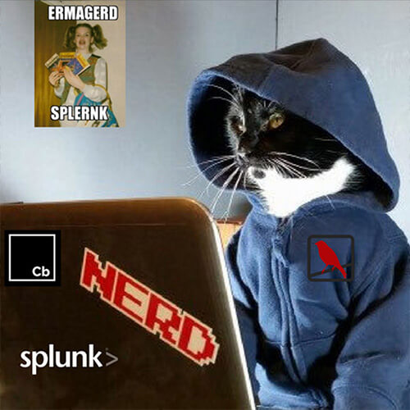
Splunk Searching
Splunk Search Processing Language (SPL)
syntax used to parse logs
index, source, sourcetype, host
Fieldname=value
Wildcard == *
AND, OR, NOT
Implicit AND
Filter search with |
Commands
WHERE or IF ;; comparators
table, timechart, chart, stats ;; format data by fields
eval, regex ;; extract/create fields
© 2023, Anna Andler. All rights reserved Introduction to Threat Hunting (with Splunk) ver. 1.2 – Adapted for CyberForce Introduction for Security Daemons 31

Slide 32
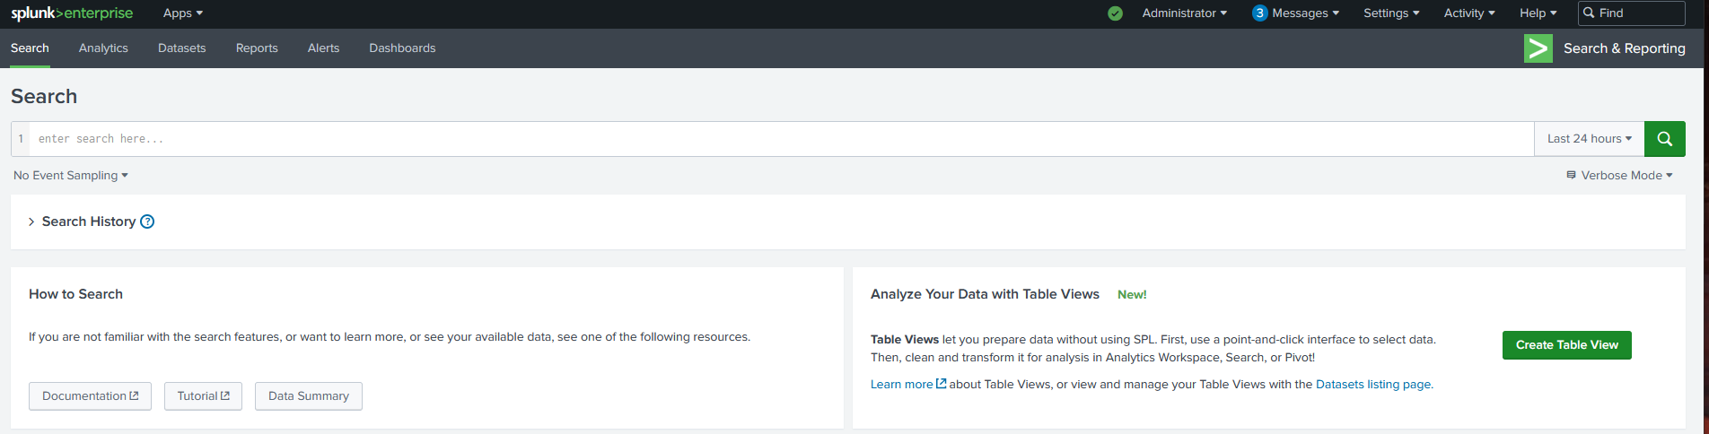
Search & Reporting App
Server Status
Server Config Settings
Current App
View All Apps
Create & View Dashboards
Create & View Alerts
Search Input Field
© 2023, Anna Andler. All rights reserved Introduction to Threat Hunting (with Splunk) ver. 1.2 – Adapted for CyberForce Introduction for Security Daemons 32

Slide 33
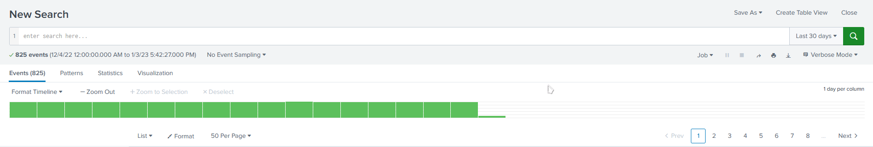
Splunk Searching 101
Search Input
Stop / Pause a Search
Export Search Results
Search Time Range
View Options
Change Event Output
Event View Options
Navigate Event View Results
© 2023, Anna Andler. All rights reserved Introduction to Threat Hunting (with Splunk) ver. 1.2 – Adapted for CyberForce Introduction for Security Daemons 33

Slide 34
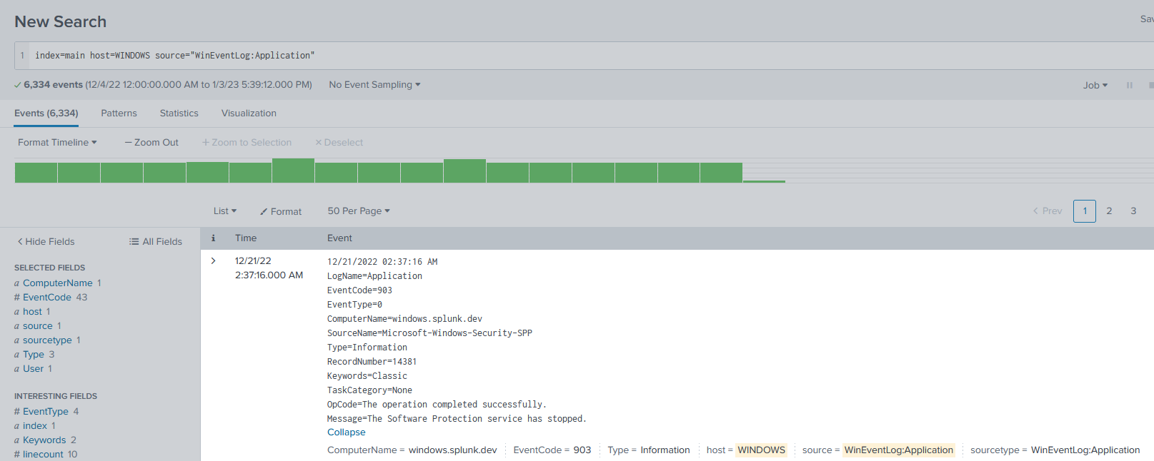
Search Option
index=main
host=WINDOWS
source=WinEventLog:Application
© 2023, Anna Andler. All rights reserved Introduction to Threat Hunting (with Splunk) ver. 1.2 – Adapted for CyberForce Introduction for Security Daemons 34

Slide 35
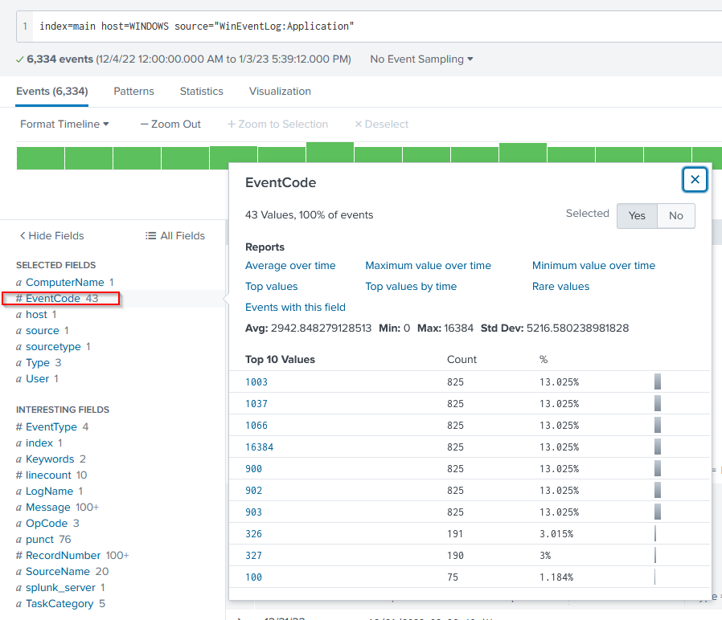
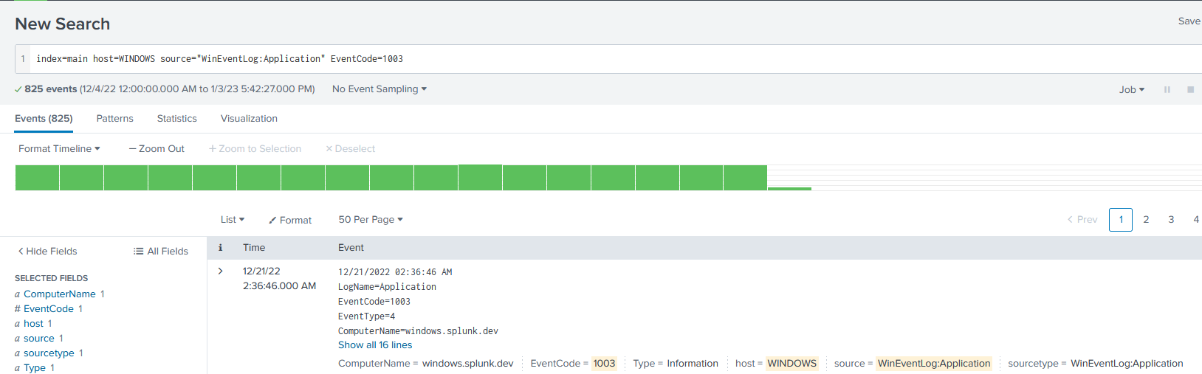
Search Option
© 2023, Anna Andler. All rights reserved Introduction to Threat Hunting (with Splunk) ver. 1.2 – Adapted for CyberForce Introduction for Security Daemons 35

Slide 36
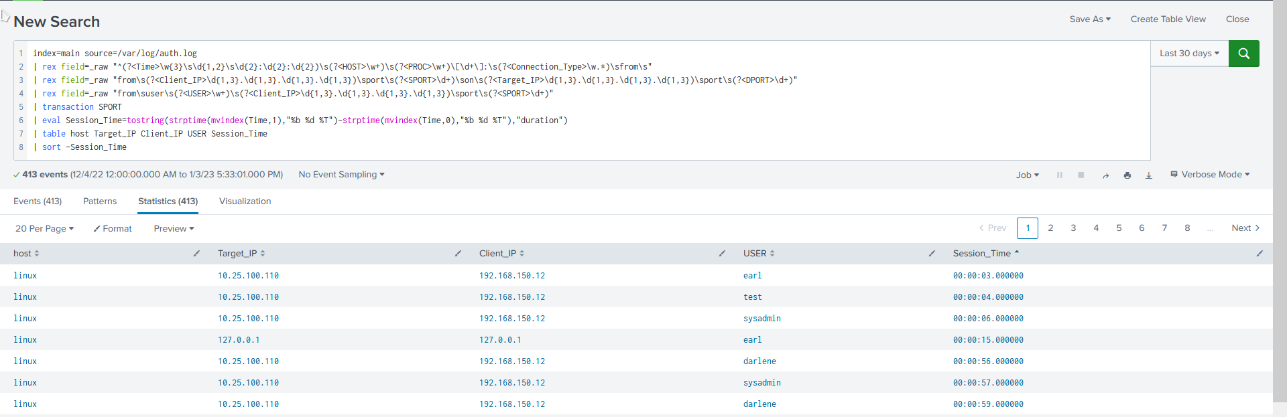
A More Complicated Search
Transaction to group events
Regex to extract new fields
Eval to make a calculated field
© 2023, Anna Andler. All rights reserved Introduction to Threat Hunting (with Splunk) ver. 1.2 – Adapted for CyberForce Introduction for Security Daemons 36

Slide 37
Dashboards & Alerts

Slide 38
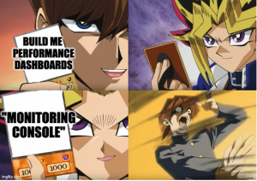
Dashboards + Alerts
Alerts – SPL queries that run on a schedule or in real-time
Automated. Have Actions – send email, send notification message, etc.
“Anomaly” – individual threat or error
e.g., unauthorized login, SQLi, hardware failure, missing logs, etc.
Dashboards – collection of SPL queries that show bigger picture
Can filter further with search fields + tokens embedded in queries
“Anomaly” – spike or decrease in overall activity for something
e.g., unusual number of login attempts, unusual amount of errors/failures, etc.
© 2023, Anna Andler. All rights reserved Introduction to Threat Hunting (with Splunk) ver. 1.2 – Adapted for CyberForce Introduction for Security Daemons 38

Slide 39
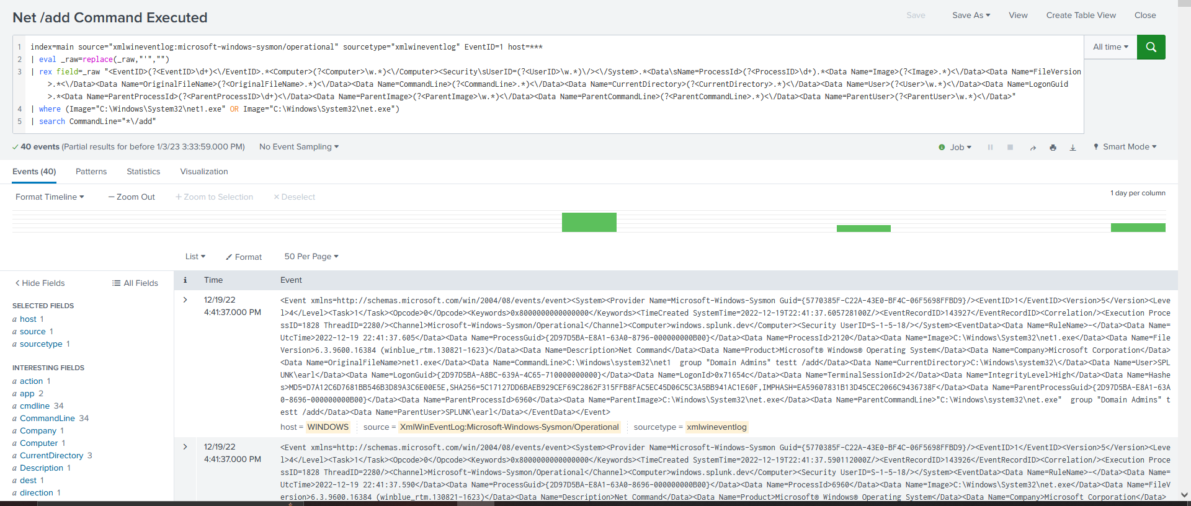
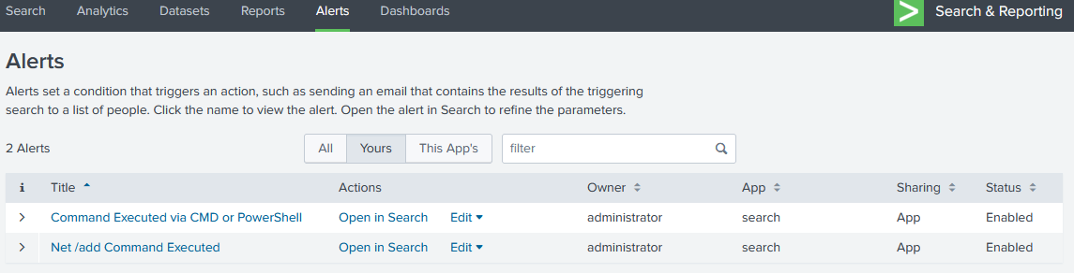
Splunk Alerts
© 2023, Anna Andler. All rights reserved Introduction to Threat Hunting (with Splunk) ver. 1.2 – Adapted for CyberForce Introduction for Security Daemons 39

Slide 40
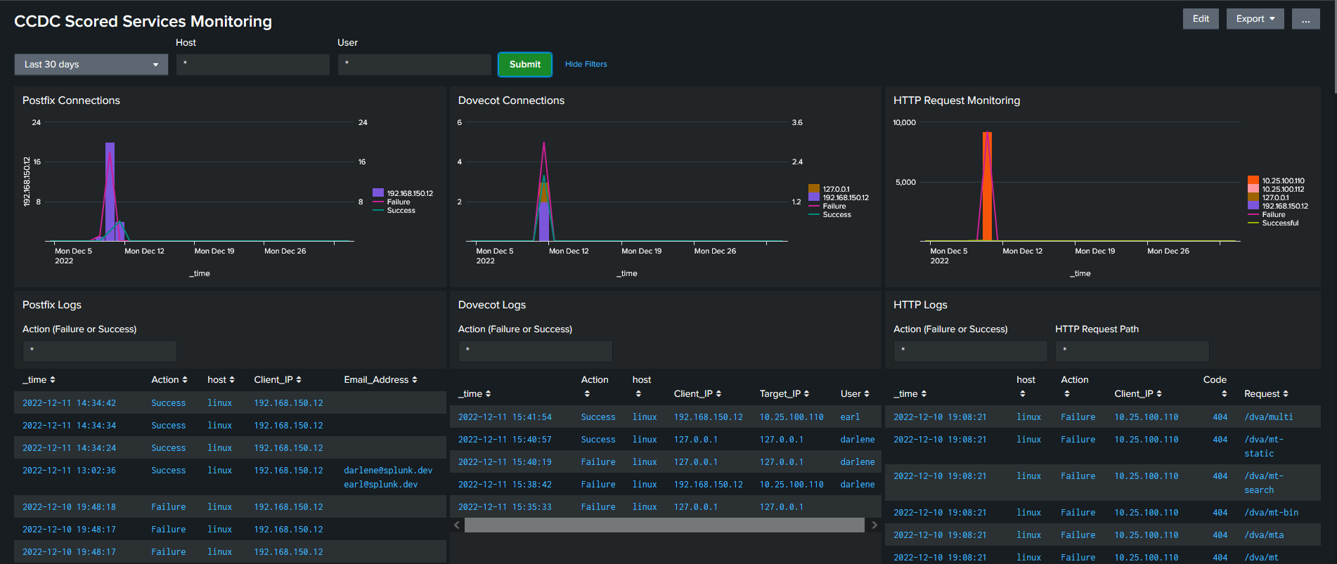
Splunk Dashboard Example
© 2023, Anna Andler. All rights reserved Introduction to Threat Hunting (with Splunk) ver. 1.2 – Adapted for CyberForce Introduction for Security Daemons 40

Slide 41
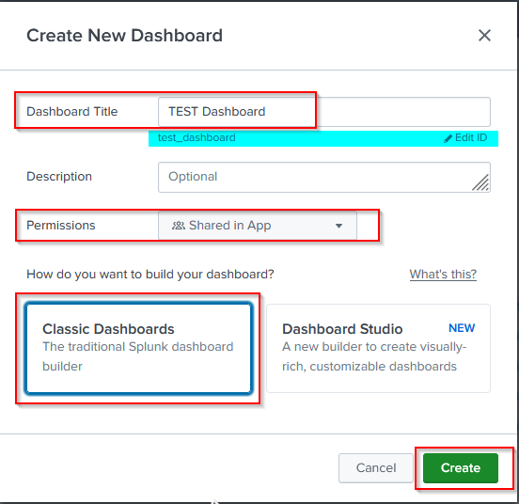
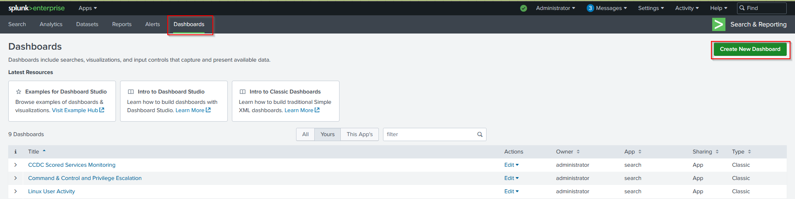
Dashboards <3
© 2023, Anna Andler. All rights reserved Introduction to Threat Hunting (with Splunk) ver. 1.2 – Adapted for CyberForce Introduction for Security Daemons 41

Slide 42
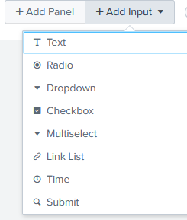
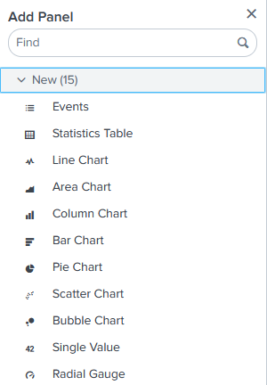
Dashboard Components
Inputs (Fields to Easily Edit Searches Used in Panels)
Panels (Visualizations)
© 2023, Anna Andler. All rights reserved Introduction to Threat Hunting (with Splunk) ver. 1.2 – Adapted for CyberForce Introduction for Security Daemons 42

Slide 43
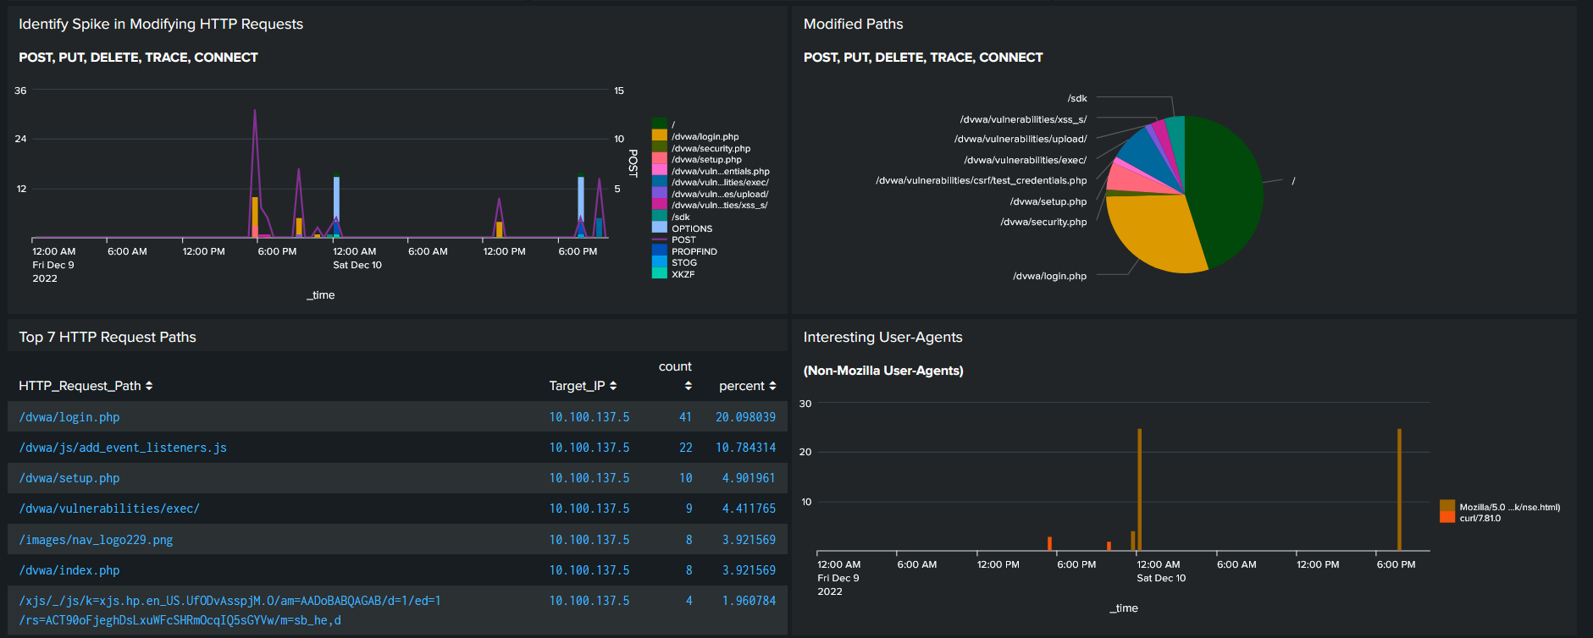
Dashboard Example
Pie Chart
Aggregated Timechart & Graph
Timechart
Statistics Table
© 2023, Anna Andler. All rights reserved Introduction to Threat Hunting (with Splunk) ver. 1.2 – Adapted for CyberForce Introduction for Security Daemons 43

Slide 44
Configuring Forwarders
Lab Time ☺
#1 Download UF Package & Unzip it
#3 Linux – Change to /opt/splunk/bin directory
#3 Windows – Run the MSI
#4 Create a Local Admin Acct
#5 Add Your Monitoring Inputs
#6 Restart The Service
© 2023, Anna Andler. All rights reserved Introduction to Threat Hunting (with Splunk) ver. 1.2 – Adapted for CyberForce Introduction for Security Daemons 44

Slide 45

Universal Forwarder Download Links
Windows –
https://download.splunk.com/products/universalforwarder/releases/9.0.1/windows/splunkforwarder-9.0.1-82c987350fde-x64-release.msi
Linux -
Debian & Ubuntu
wget -O splunk.deb https://download.splunk.com/products/ universalforwarder /releases/9.0.1/linux/splunkforwarder-9.0.1-82c987350fde-linux-2.6-amd64.deb
dpkg -I splunk.deb
Centos, Fedora, RHEL
wget -O splunk.tgz https://download.splunk.com/products/universalforwarder/releases/9.0.1/linux/splunkforwarder-9.0.1-82c987350fde-Linux-x86_64.tgz
tar –xvzf splunk.tgz
© 2023, Anna Andler. All rights reserved Introduction to Threat Hunting (with Splunk) ver. 1.2 – Adapted for CyberForce Introduction for Security Daemons 45

Slide 46
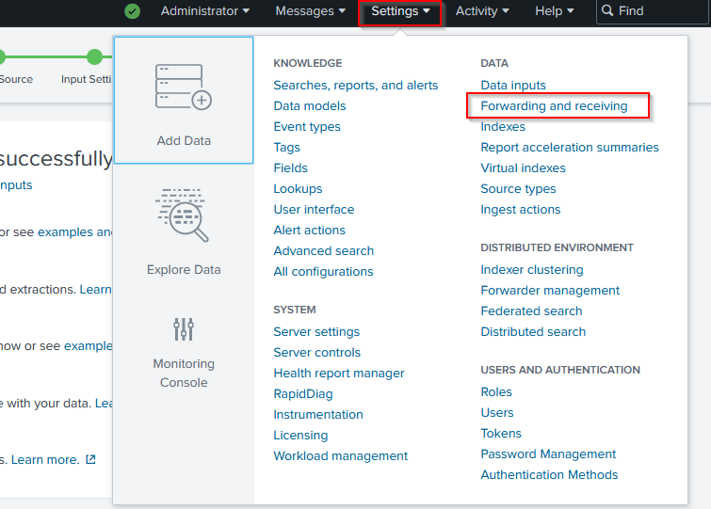
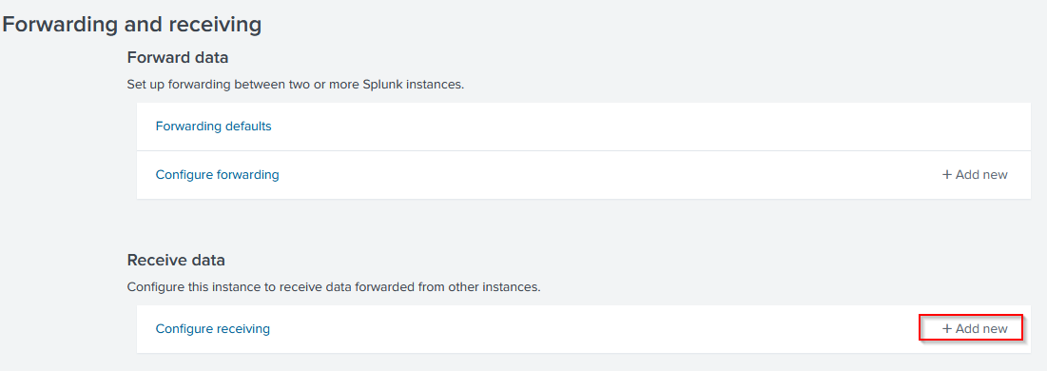
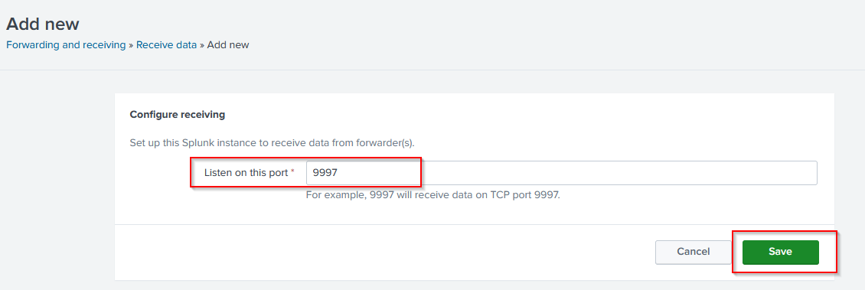
Configuring Receiving - Universal Forwarder
© 2023, Anna Andler. All rights reserved Introduction to Threat Hunting (with Splunk) ver. 1.2 – Adapted for CyberForce Introduction for Security Daemons 46

Slide 47
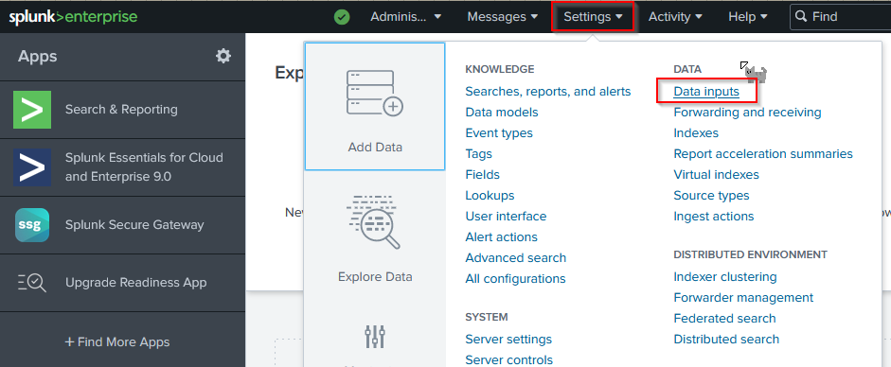
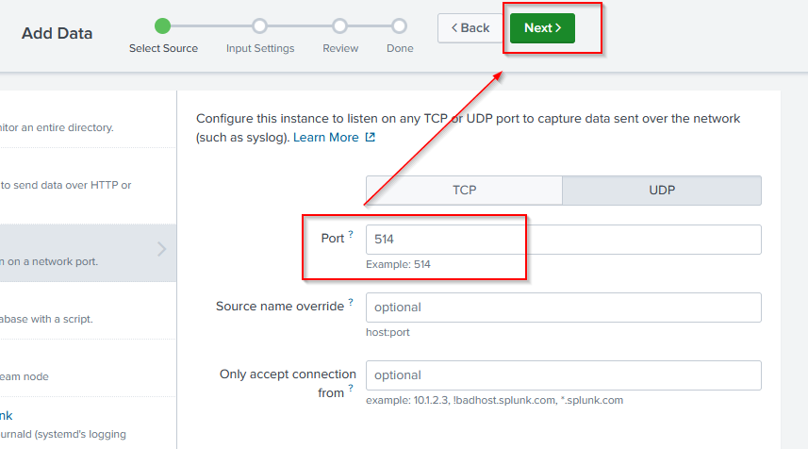
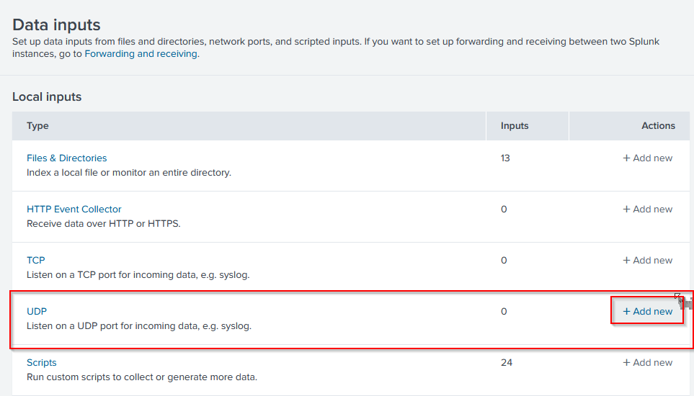
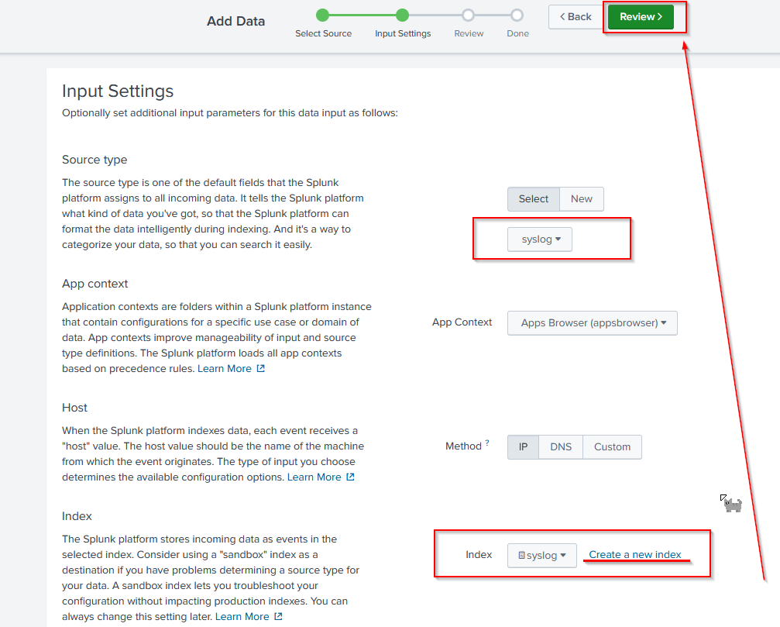
Configuring Receiving - SYSLOG
© 2023, Anna Andler. All rights reserved Introduction to Threat Hunting (with Splunk) ver. 1.2 – Adapted for CyberForce Introduction for Security Daemons 47

Slide 48

Demo Time (Parsing Data & Dashboards)
Any Questions?!
© 2023, Anna Andler. All rights reserved Introduction to Threat Hunting (with Splunk) ver. 1.2 – Adapted for CyberForce Introduction for Security Daemons 48

